Slide 1

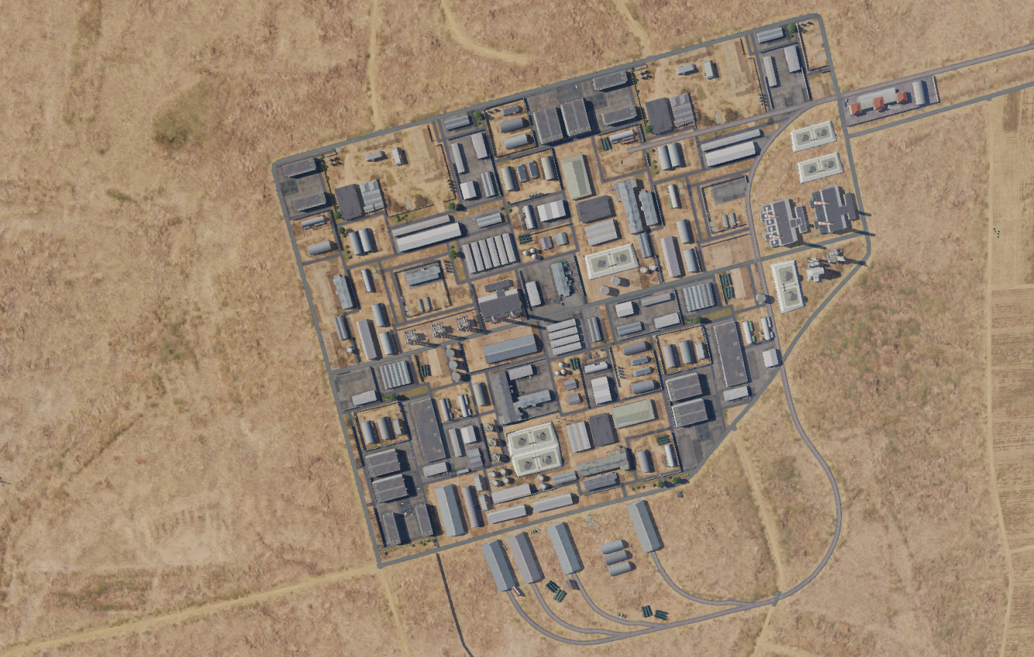
SYTGT058 Damascus Chemical Weapon research facility
N
2
058
4
1
DESIRED POINT of IMPACT:
DPI 1 - N33 25.031 E036 41.150/ 1965ft / 2x 500 lbs
DPI 2 - N33 25.164 E036 41.055/ 1990ft / 1x 2000lbs
DPI 3 - N33 24.872 E036 41.298/ 1929ft / 1x 500 lbs
DPI 4 - N33 25.112 E036 41.405 / 1951ft / 1x 500 lbs
DPI 1: Chemical production facility
DPI 2: Office spaces and research laboratory
DPI 3: Chemical storage
DPI 4: Chemical storage
NOTE: SYTGT058 is colocated with SYTGT063 and SYTGT064 in Damascus Idustrial Park.
NOTE: that there are three powerplants in this industrial park. Destruction of these likely will shut down production to the entire industrial park.
3
= Collateral Damage Concern
CDC: All targets that are not assigned as targets are civilian, but of specific collateral damage concern are the locations listed in the picture. These are chemical tanks with highly flammable chemicals and a destruction of these might lead to a fire that might spread to several other buildings. DPI 1 is also between two chemical installations that handle the dangerous civilian chemicals. Office building next to DPI 2 is a civilian office building with the administration for this entire industrial park.

Slide 3
